Slide 1

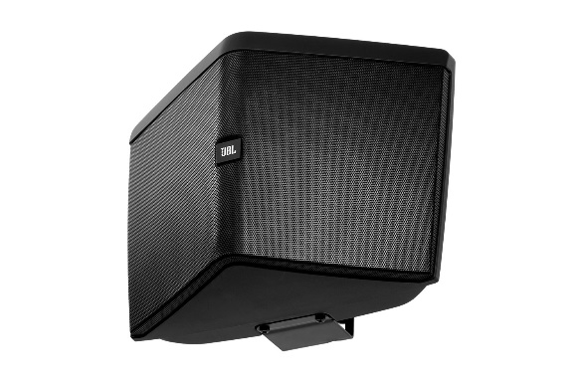
음향 시스템 사양서
WIDE COVERAGE SPEAKER
JBL_CONTROL HST
SPECIFICATIONS
System type : 5-1/4" WIDE COVERAGE SPEAKER
Frequency Range (-10dB) : 50Hz ~ 20kHz
Frequency Response (+/-3dB) : 68Hz ~ 18kHz
Power rating : 100W cont. (PEAK 400W)
Sensitivity (2.83V@1m) : 88dB
Directivity factor (Q) : 5.4
Directivity index (DI) : 7.2 dB
Crossover Network : 1.6 kHz
Coverage Angle : 180°(H) x 160°(V)
Impedance : 8 ohm
Transformer Taps : 70V = 60W, 30W, 15W & 7.5W
: 100V = 60W, 30W, 15W
Transducers : LF CMMD™ ceramic metal matrix diaphragm cone(5-1/4"), HF 1”
Enclosure : Fiberglass-reinforced ABS
Environmental : IP-54
Dimension (H x W x D)mm : 362 x 256 x 184 mm
Weight : 3.6 kg
FEATURES
180° 수평커버리지
벽면 반사에 대한 음향 솔루션
2개의 수평 트위트 배치 (특허출원)
70V 또는 100V 하이임피던스 사용 가능

