Slide 1

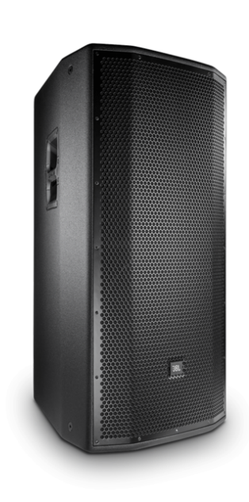
음향 시스템 사양서
15“ 3-WAY POWERED SPEAKER
JBL_PRX835
SPECIFICATIONS
System type : Self Powered 15”, Three-way, bass-reflex
Frequency Range (-10dB) : Normal 35Hz ~ 20kHz
: Boost 34Hz ~ 20kHz
Frequency Response (-3dB) : Normal 42Hz ~ 20kHz
: Boost 39Hz ~ 20kHz
Input impedance : 20K ohms (Balanced), 10K ohms (Unbalanced)
Dynamic Control : dbx type IV™ limiter circuit
Power amp design : Highly etticient Class-D amp
Coverage : 90 x 50 deg.
Crossover frequencies : 2.1 kHz
Power rating : 1500W cont. (750W x2)
Directivity index (DI) : 10.5 dB
Directivity factor (Q) : 11.2
Max SPL : 138 dB Peak
Transducers : LF 15“, MF 6.5”, HF 1.5”
Finish : Obsidian DuraFlex™ finish
Connectors : 2 x Balanced XLR, 2 x Unbalanced RCA
Power input : 100V ~ 240V, 50/60Hz
Dimension (H x W x D)mm : 938 x 446 x 539
Weight : 32.38 kg
FEATURES
디퍼렌셜 드라이브 기술 적용
듀얼 15인치 저음역대 드라이버로 낮은 노이즈 및 높은 SPL 제공
고품질 CLASS-D 파워 앰프 내장
무선 WI-FI를 통한 DSP, EQ 제어
90 ° x 50 °의 커버리지

